Slide 1


Co-construction of training contents in sport mental training in Europe

Slide 2


THE PROJECT
THE “EUROMENTAL” PROJECT has been financed by the Erasmus + Program, Action Type “KA220-HED – Cooperation partnerships in higher education”. Euromental will spread over a period of 36 months.
The association among mental skills and performance enhancement is continuously highlighted by coaches and athletes, although they are not completely aware about the underpinning psychophysiological mechanisms.
Mental skill trainers must seek the autonomy of the athlete because mental preparation is part of the training process.

Slide 3
OBJECTIVES
The project has three main goals:
1/Co-build training content in sports psychology and mental preparation for athletes
2/Disseminate good practices in training and mental preparation towards stakeholders, professionals, and students in these fields
3/Fostering and energizing relations between European universities
The goals will be reached by developing educational courses and by organizing multiplier events. This project uses the bundled knowledge of experts on mental training and combines it with the newest ways of teaching and dissemination

Slide 4
TARGET
1st – 4th levels of the European Qualification Framework for coaches (60 hours for the entire educational course; 10 hours for each teaching unit)
5th level of the European Qualification Framework for Psychologists and Sport Scientists (150 hours for the entire educational course; 25 hours for each teaching unit)
The educational courses are NOT intended for athletes who seek for sport psychological support.
Please note that after attending the educational courses you CANNOT do sport psychological interventions aimed to address mental health issues.

Slide 5
STAKEHOLDER
Stakeholders should raise the awareness on the importance of mental skills in performance to have athletes and coaches aware of their possibilities and limits, able to self-regulate, to recognize both early signs of burnout and the influence of their emotions on performance, to have the means to understand mental factors that affect performance and to regulate them individually, the importance of leadership in the group.
Physical, technical, and tactical training are not enough for the athlete’s well-being and optimal performance: mental training, through a personalized approach, is the key to opening the doors of a professional and personal success.

Slide 6







PARTNERS= COUNTRIES

Slide 7






CONSORTIUM
Università degli studi Gabriele d’Annunzio di Chieti-Pescara (Italy)
Université Lyon 1 Claude Bernard (France)
Universidad De Extremadura (Spain)
Universytet Gdański (Poland)
Karlstads Universitet (Sweden)
Humboldt-Universitaet Zu Berlin (Germany)

Slide 8
TEACHING UNITS

Slide 9
6 Teaching Units (TUs)
Engagement process for athletes, coaches and stakeholder
Group dynamics and leadership development in athletes and coaches
Practical application of psychological strategies
Optimal and non-optimal performance, psychophysiological states, and stress-recovery balance
Psychological (Mental) Skills Training
Emotional processes and techniques for emotional regulation

Slide 10

Unit 1 : Engagement process for athletes, coaches and stakeholders

Slide 11


Engagement process for athletes, coaches, and stakeholders
Emma Guillet Descas / Virginie Nicaise / Guillaume Martinent/
Francisco Miguel Leo/Tomás García-Calvo/Juan José Pulido / Miguel Ángel López-Gajardo
Main objective of the teaching unit
The module contributes to the fulfillment of the educational goals of the Euromental project, by providing the knowledge and the competences related to the athlete and coaches engagement and the strategies to promote and foster an environment to improve the motivational processes and the engagement quality.

Slide 12
Acquisitions
At the end of the class, the student will have to demonstrate the acquisition of:
1. Knowledge and understanding of different theories and studies about motivation processes and engagement.
2. Knowledge about and ability to explain antecedents, moderators, and mediators of athletes and coaches engagement.
3. Knowledge and understanding of strategies to develop a positive environment to develop athletes and coaches engagement.
4. Ability to develop and implement strategies to improve engagement in a real context.
5. Ability to analyze and evaluate the strategies that they are implementing.
6. Knowledge and understanding of using different instruments or tools to measure antecedents, moderators, mediators and consequences.

Slide 13
Contents
Introduction: Engagement athletes and coaches consequences
2. Theories:
• Self-Determination Theory in sport
• Achievement Goal Theory
• Expectation –Value Model
• Exchange social model
3. Antecedents: external or environmental factors
• Coaches
• Family
Peers
• Organization
4. Strategies / Scenarios:
• Coaches
• Family
• Peers
• Organization
5. Instruments:
• Consequences: Engagement and Burnout.
• Motivational Process: Motivation / Basic Psychological Needs
• Antecedents: Coaches /Family/Peers/Organization

Slide 14
Unit 2 : Group dynamics and leadership development in athletes and coaches

Slide 17
Unit 3 : Practical application of psychological strategies

Slide 20
Unit 4: Optimal and non-optimal performance, psychophysiological states, and stress-recovery
balance

Slide 23
Unit 5 : Psychological (Mental) Skills Training

Slide 24
Mental training
"Mental training is a process in which athletes, usually with the help of consultants or coaches, systematically use strategies and techniques to build mental skills and well-being to enhance their performance, development, and experiences in sport. Enhancing mental health in athletes is an important objective for mental performance consultants (Vealey, 2023, p. 1)".​

Slide 25
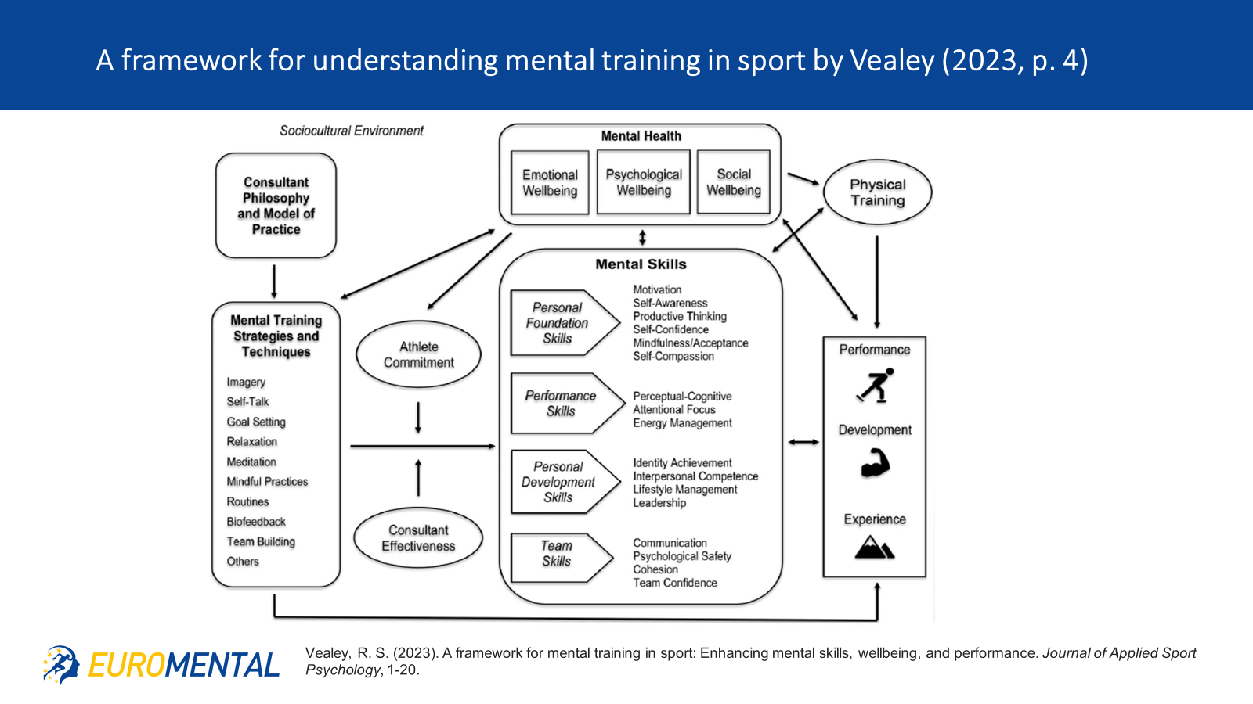

Slide 26
Example of strategies and techniques:
1. Attention and concentration
2. Arousal regulation
3. Imagery
4. Self- talk

Slide 27
Concentration and Attention definition
Concentration
Process of selecting from multiple sources of information those most relevant to some goal, and of managing the interference from non-selected sources.
It is the personal ability to exert deliberate effort and to maintain focus on relevant environmental cues in a given situation and a given time.
Attention
Process of focusing mental effort on sensory or mental events to increase the elaboration and perception; limited capacity.
(Moran, 2012)

Slide 28
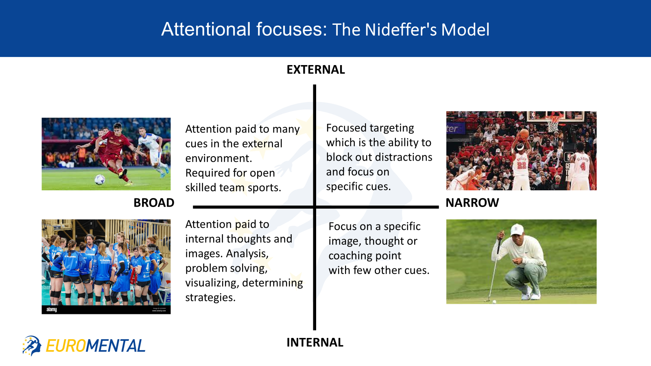

Slide 29
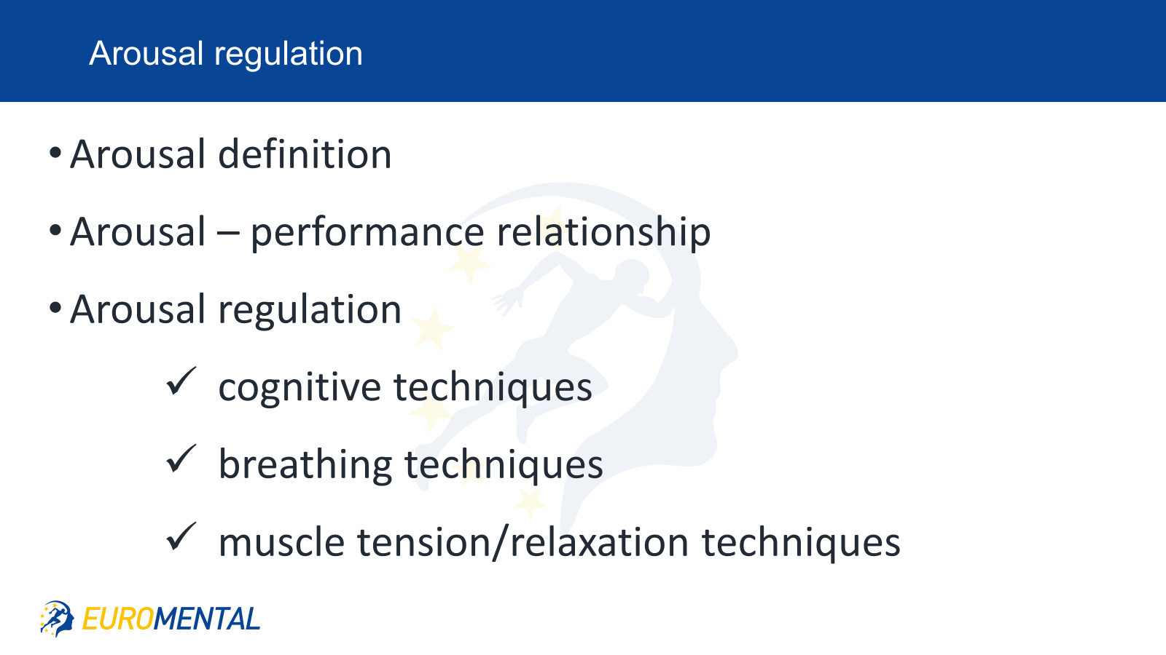
Arousal regulation

Slide 30
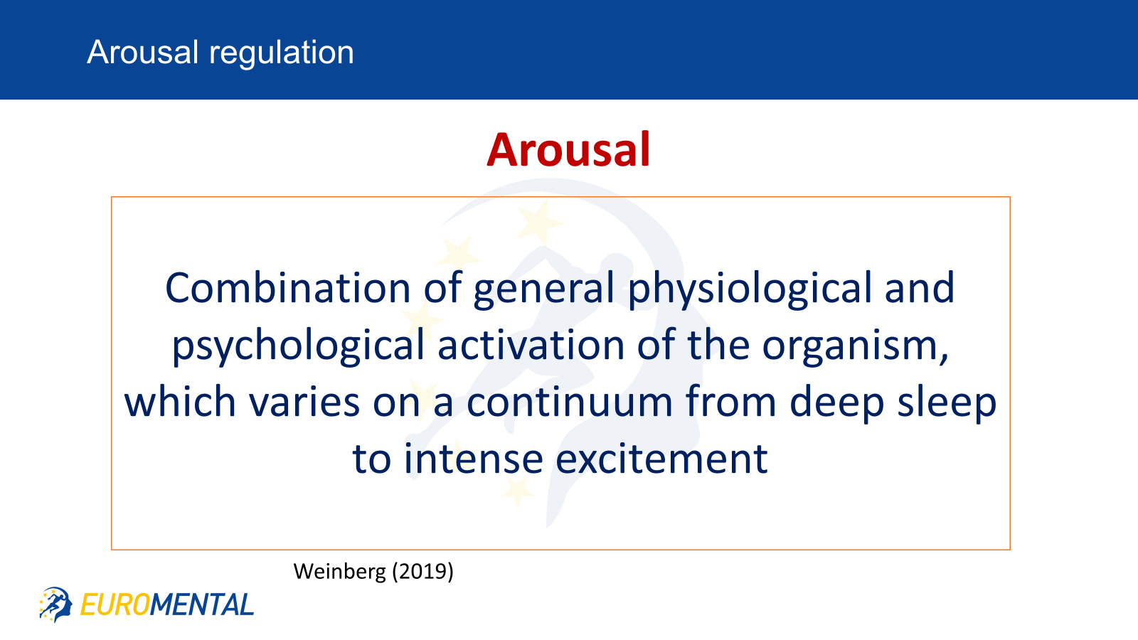

Slide 31
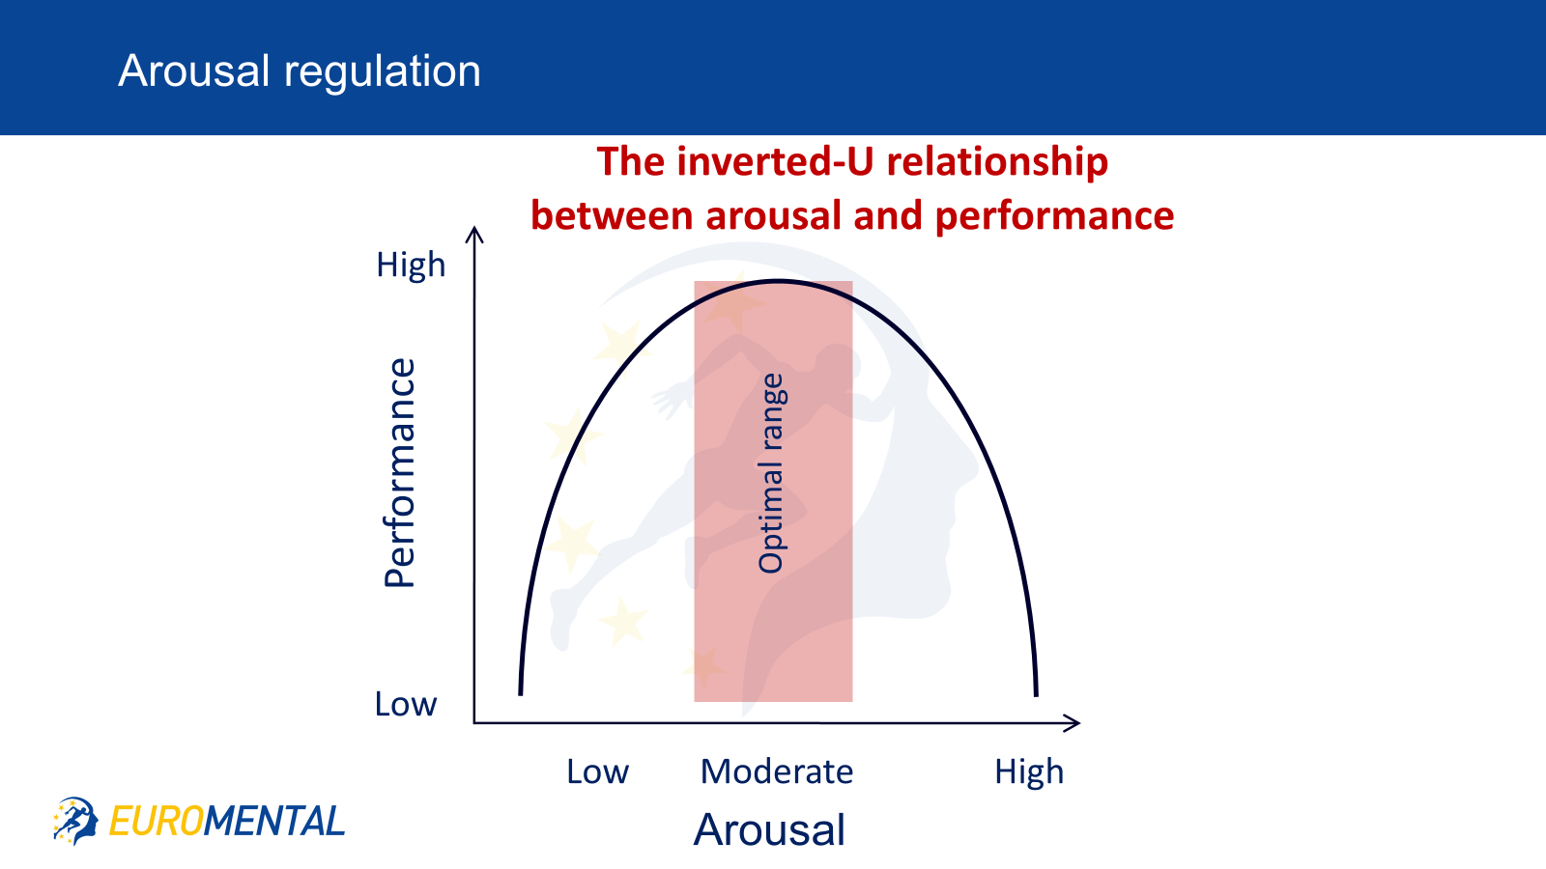

Slide 32
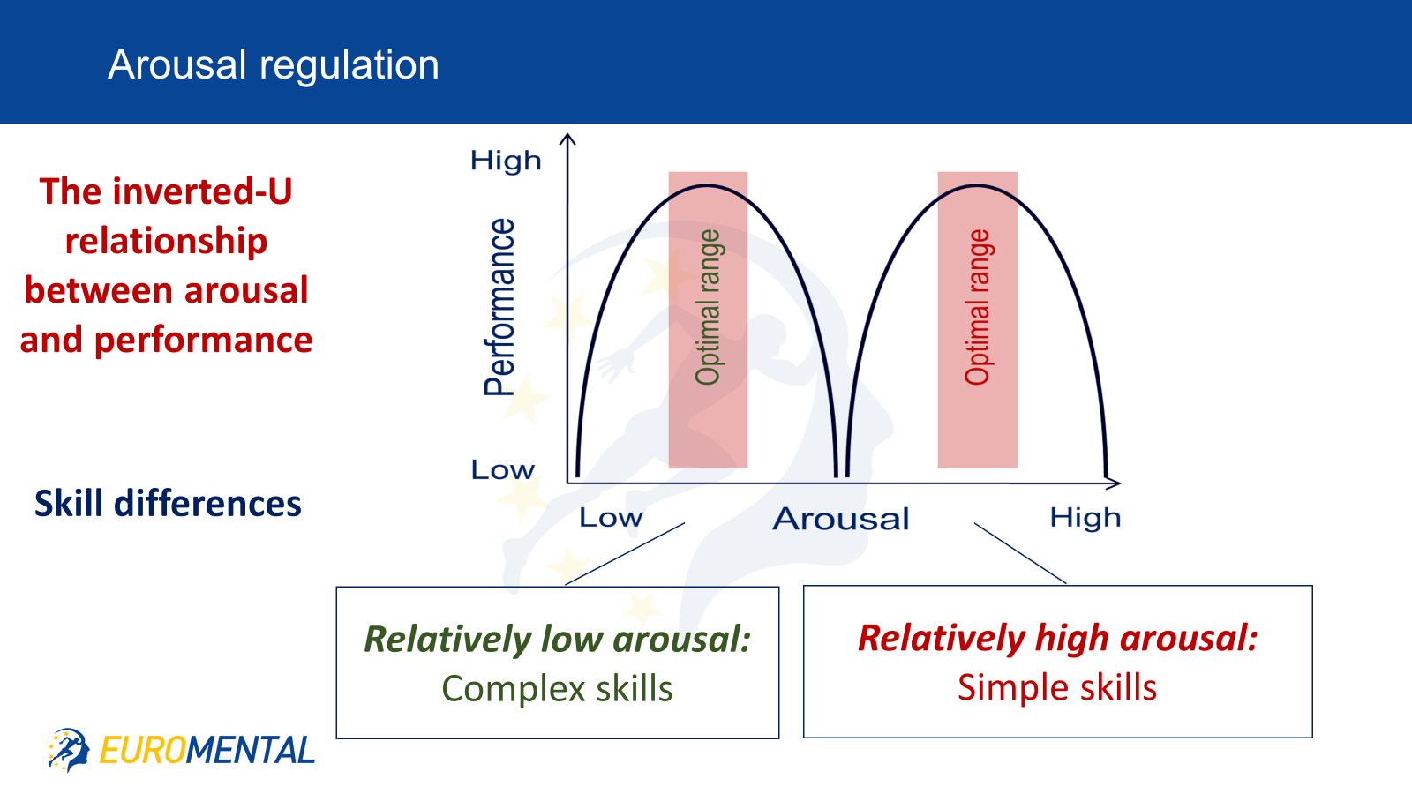

Slide 33
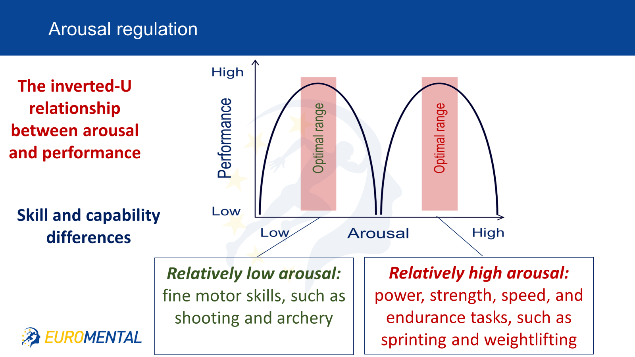

Slide 34
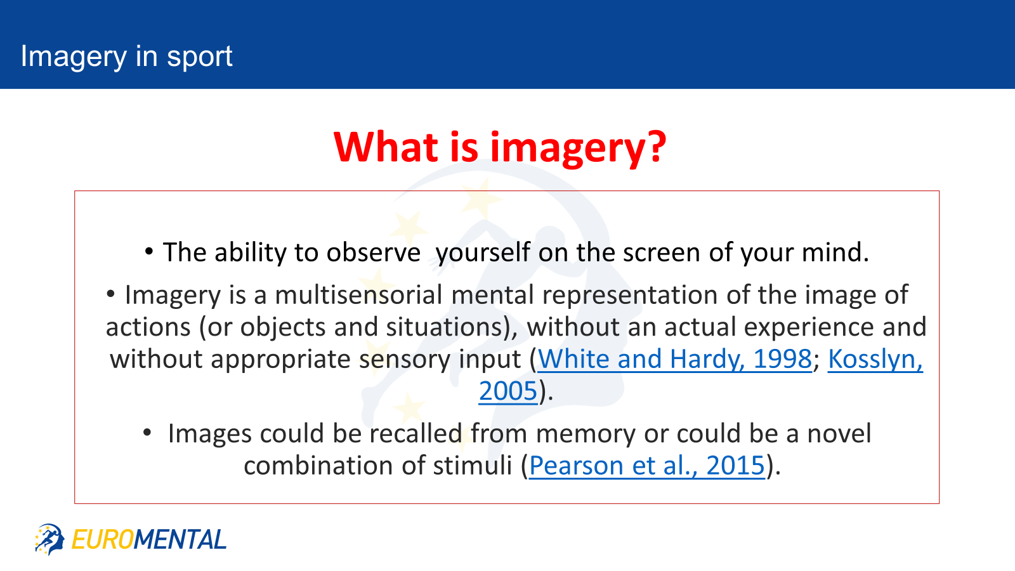

Slide 35
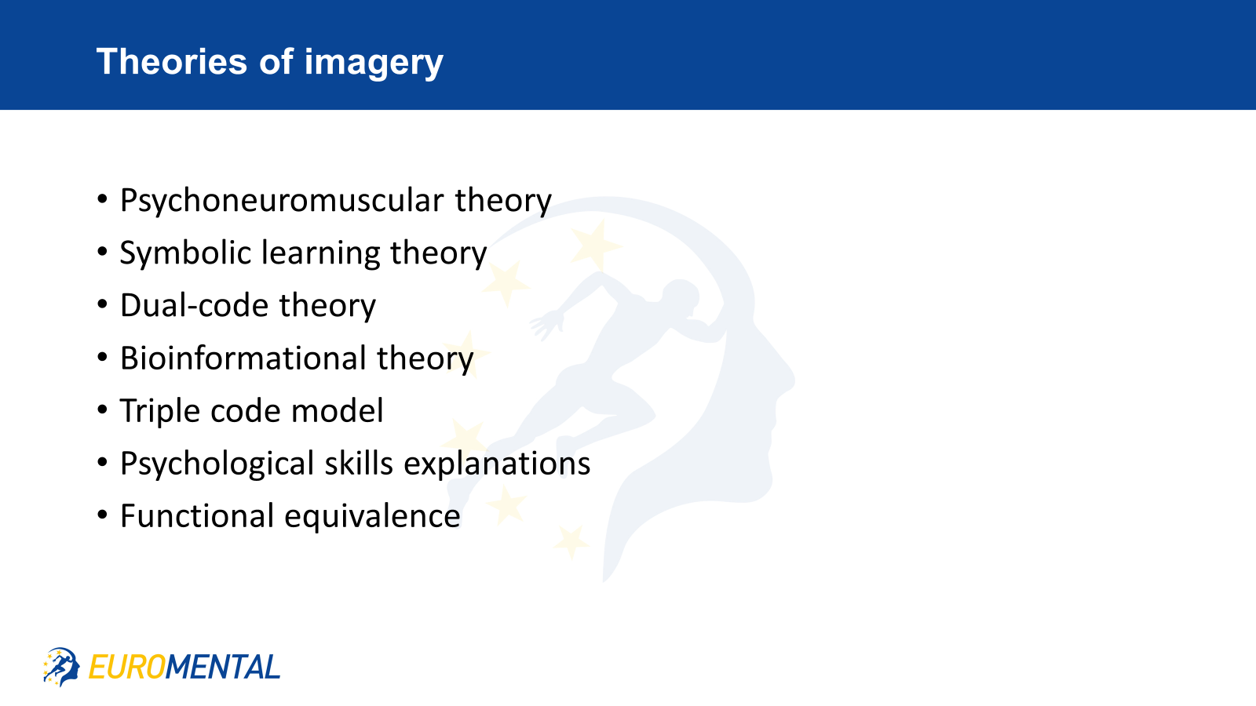

Slide 36
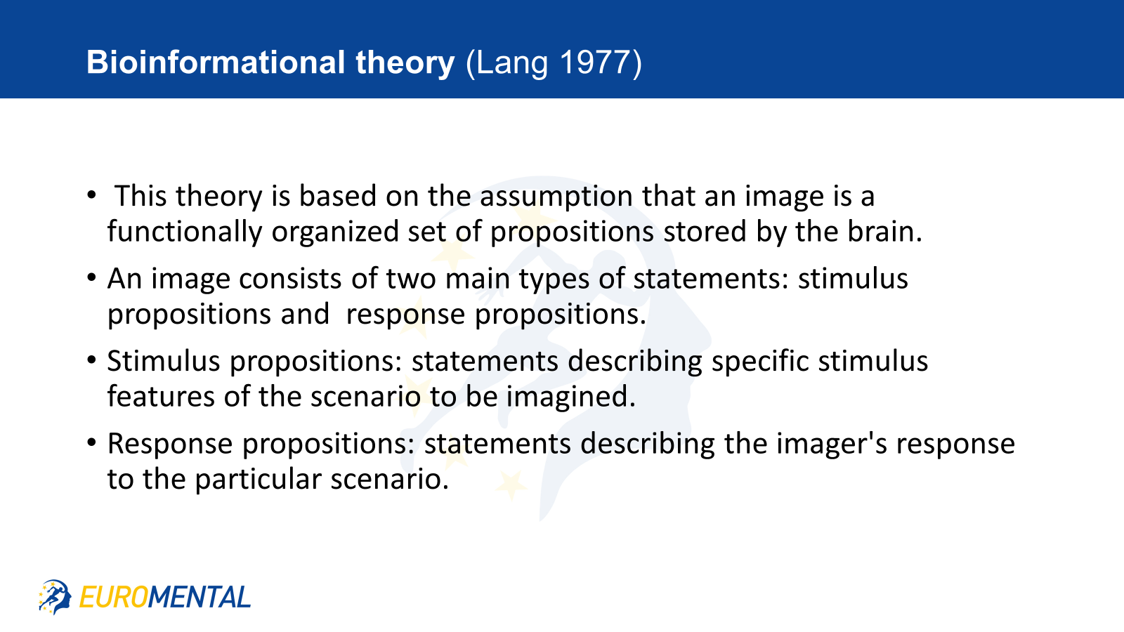

Slide 37
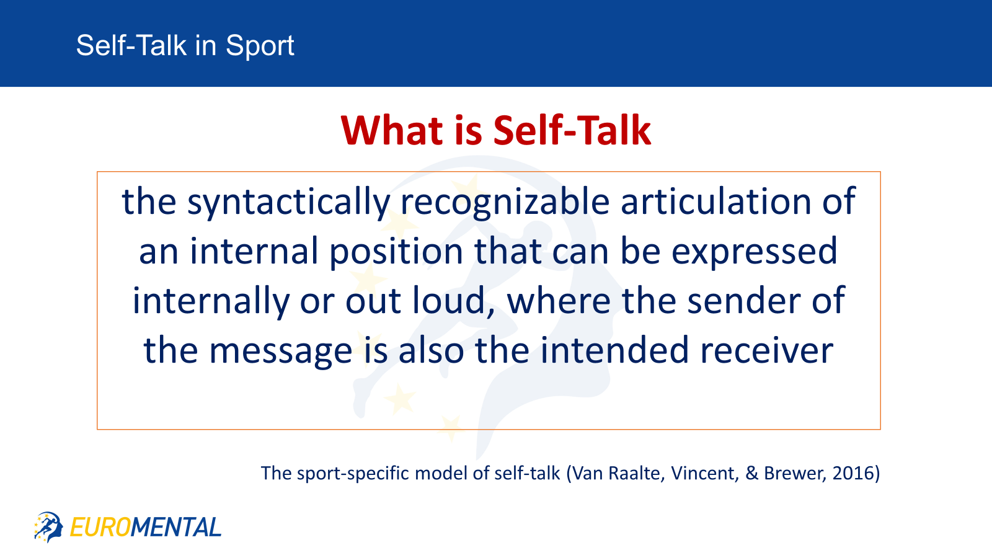

Slide 38
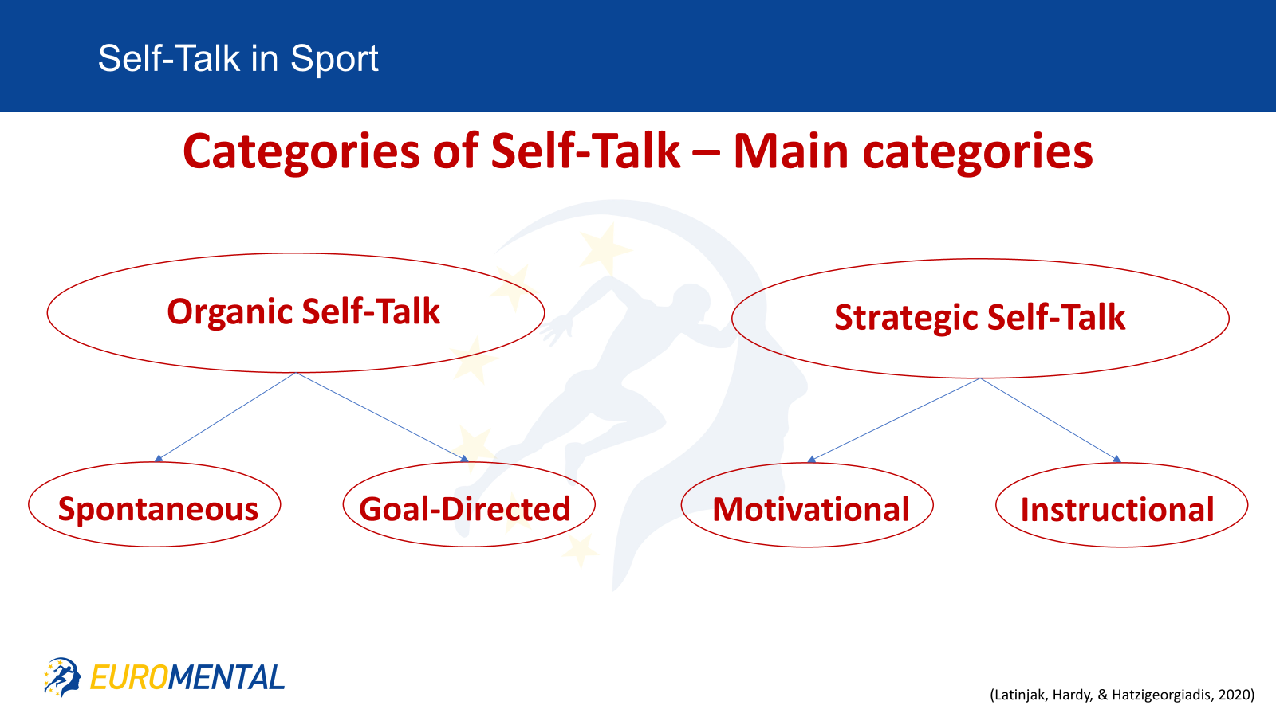

Slide 39
PETTLEP model (Holmes and Collins,2001)
PHYSICAL​
ENVIROMENT​
TASK​
TIMING​
LEARNING​
EMOTION​
PERSPECTIVE

Slide 40
Unit 6 : Emotional processes and techniques for emotional regulation

Slide 43
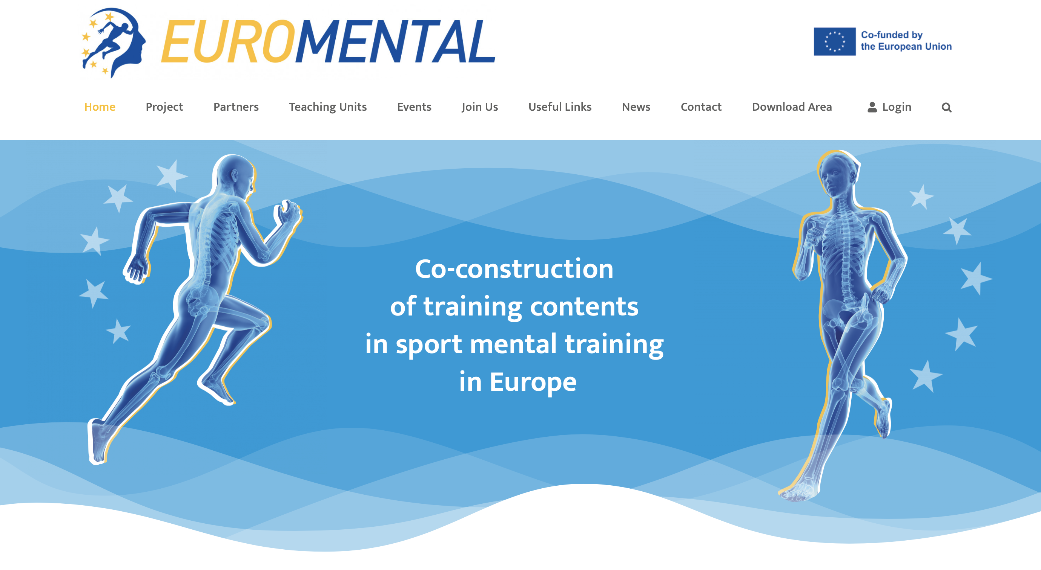
WEBSITE
Please, visit our website
www.euromental.eu

